Slide 1
Network Monitoring
Team 17 Palash Choudhary Saksham Arora Shreyas Verma

Slide 2
Network Monitoring is crucial
Performance Optimization
Identify bottlenecks, latency issues and optimize based on insights gained from monitoring
Fault Detection and Troubleshooting
Early detection of failures in network and rapid troubleshooting
Capacity Planning
Anticipate future requirement and prevent resource constraints using data on network traffic, resource utilization
Cost Management
Monitoring helps in effective cost management

Slide 3
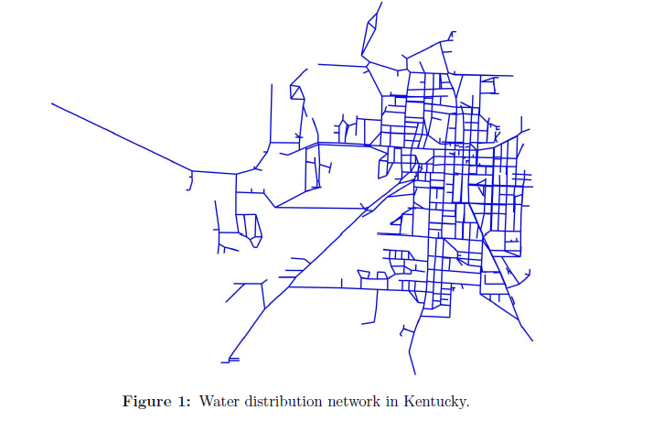
Problem Background
Kentucky's main network operator is interested in allocating pressure sensors on nodes to detect pipe bursts in its water distribution network.
1123 pipes
811 nodes
2.09 million gallons of water per day
5,010 customers

Slide 4
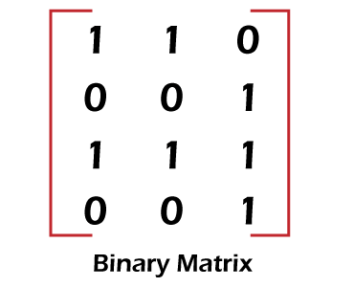
Problem Details
N1 N2 N3
|Ɛ|: Set of 1123 network pipes
|V|: Set of 811 nodes
F is detection matrix of size 1123 X 811
F Є {0,1} for |Ɛ| X |V|
F(e,v) = 1 if a sensor is placed at location v Є V can detect a burst of pipe at e Є Ɛ
P1
P2
P3
P4

Slide 5
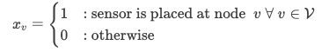
Problem 1: Minimum number of sensors and their location to detect any pipe bursts
We need to identify the nodes where we place the sensors so that any pipe burst in the network can be detected and minimize the number the number of such sensors
It is a minimization problem
Decision Variables
Whether a sensor is placed at a node in set |V|
Binary variable Є {0,1}

Slide 6
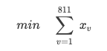
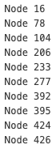
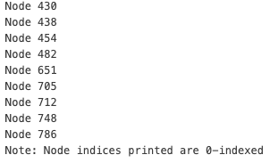
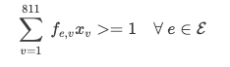
Problem 1: Integer Programming Approach
Objective Function
Minimum number of sensors
19
Constraints
A pipe burst is sensed by at least one sensor

Slide 7
Problem 2: Maximize the expected number of pipe burst detected given "b" pressure sensors
We need to identify the location of "b" sensors so that we can identify maximum number of expected pipe bursts
Each pipe bursts independently with probability p=0.1
It is a maximization problem
Iterating for number of sensors "b" Є {0,…,20}

Slide 8
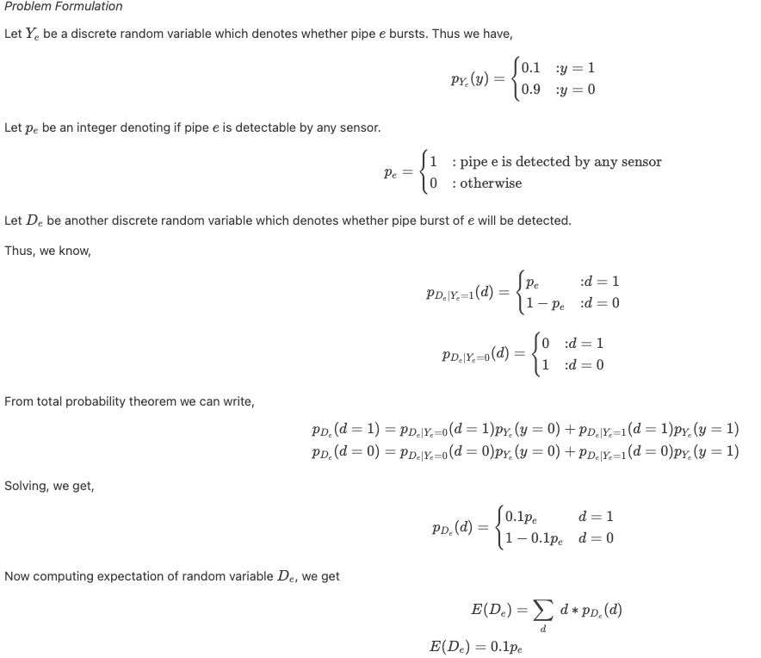

Slide 9
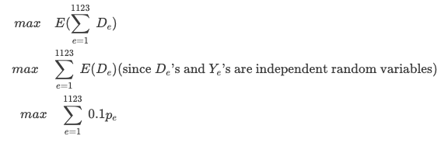

Slide 10
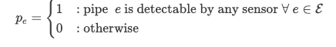
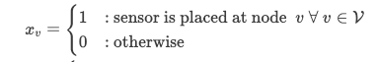
Problem 2: Maximize the expected number of pipe burst detected given "b" pressure sensors
We need to identify the location of "b" sensors so that we can identify maximum number of expected pipe bursts
Each pipe bursts independently with probability p=0.1
It is a maximization problem
Iterating for number of sensors "b" Є {0,…,20}
Decision Variables
Whether a pipe in set |Ɛ| is detected by any sensor
Binary variable Є {0,1}
Whether a sensor is placed at a node in set |V|
Binary variable Є {0,1}

Slide 11
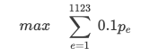
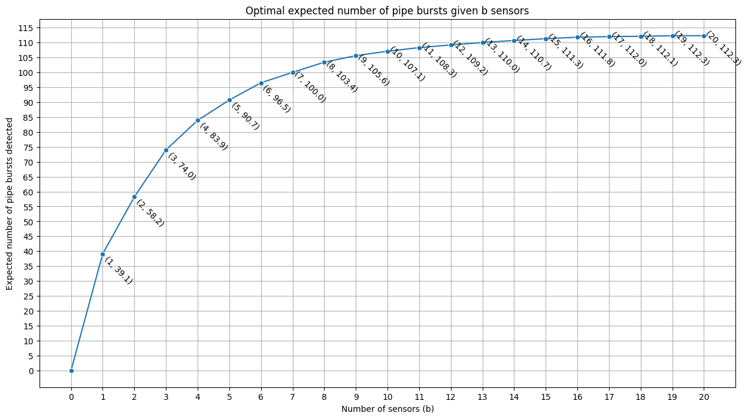
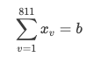
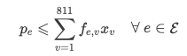
Problem 2: Integer Programming Approach
Objective Function
Maximum objective for b = 19
Optimal value = 112.3
Constraints
Number of sensors are limited to b
Pipe cannot be detected if no sensor is placed on pipe

Slide 12
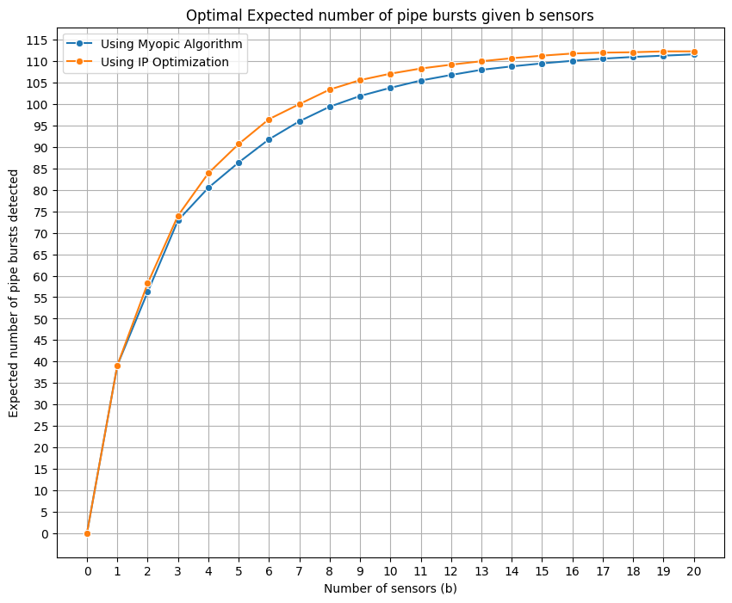
Problem 2: Iterative Greedy Approach
Sequential approach of myopically selecting the best node to place the sensor at each iteration
Algorithm:
Place first sensor at node that detects maximum expected number of pipes burst
Then take the second sensor and place it at a node that detects maximum expected number of pipe bursts that were not previously detected, and so on until all sensors are placed
Observations
Greedy approach approximates the optimized solution very well
It has good runtime
Since it is greedy, it is not able to maximize the objective function as well as the IP formulation

Slide 13
Problem 3: Minimize the highest criticality of a pipe that is not detected by any sensor
Criticality of a pipe is given as "We"'; higher the "We", more critical the pipe
We want to place the sensors so that highest criticality of a pipe that is not detected is minimized
When b = 0, highest criticality = 1, when b --> minimum sensors required, criticality = 0
It is a minmax problem
Decision Variables
Whether a pipe in set |Ɛ| is detected by any sensor
Binary variable Є {0,1}
Whether a sensor is placed at a node in set |V|
Binary variable Є {0,1}

Slide 14
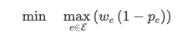
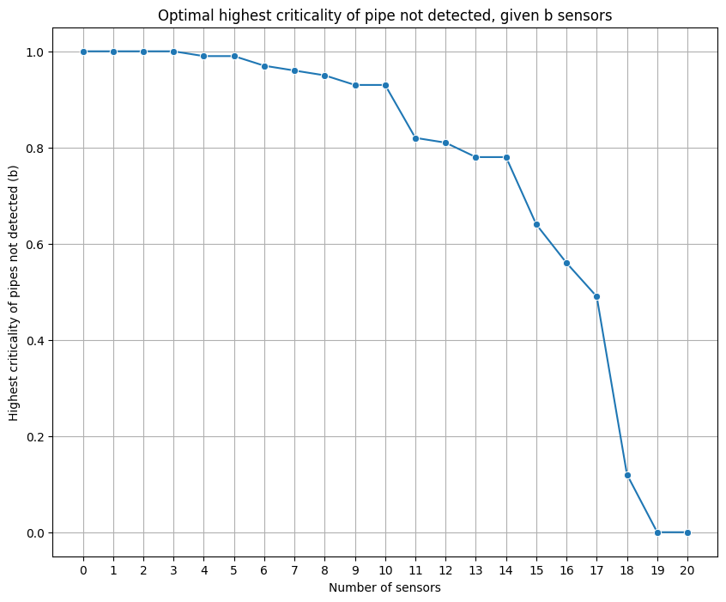
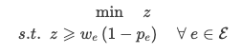
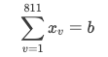
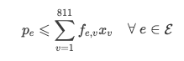
Problem 3: Integer Programming Approach
Objective Function
Highest Criticality for b = 19
Optimal value = 0
Constraints
Linearizing max function
Number of sensors are "b"
Pipe burst, if detected, is detected by at least one sensor

Slide 15
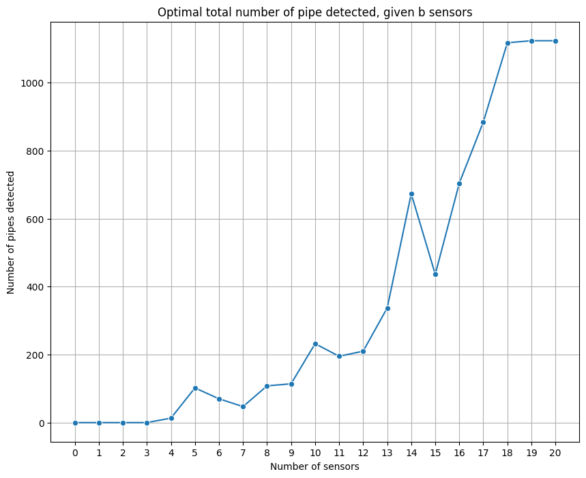
Problem 3: Insights and Considerations

Slide 16
Thank You

